Slide 1
V. Transcription (DNA-directed RNA synthesis)
A. Prokaryotes: RNA polymerase, Promoters – sigma factor
B. Eukaryotes: RNA polymerases, Promoters – transcription factors
1 strand of dsDNA used as template to synthesize complimentary ssRNA (in DNA A directs U (not T) in complimentary RNA.
RNA pols catalyze joining of NMPs 5’→3’ using NTP substrates.
RNA pols do NOT proofread (no 3’-5’ exonuclease).
RNA pols can initiate synthesis without the need for a ‘primer’.
Coding strand

Slide 2
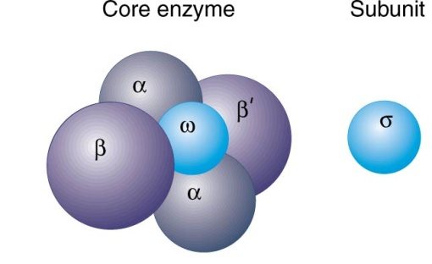
A. Prokaryotes
1 RNA pol synthesizes all RNAs (except primers in DNA synthesis).
RNA pol holoenzyme: multiple subunits.
sigma subunit (σ) = important in initiating transcription; helps RNA pol bind correct template strand & recognize gene promoters = DNA sequences “upstream” of transcription initiation site.
different σ factors recognize different promoters (σ70 = most genes; σ32 = heat shock proteins; σ28 = flagella & chemotaxis genes).
2 DNA sequences (-35 & -10) found in most prokaryotic promoters – “upstream” of transcription start site (+1).
Coding strands with promoters for different genes.
All genes have a promoter.
Some promoters recognized better than others → increased rate of initiating transcription.
Consensus sequences: sequence of nucleotides found most often in each position
+1 = site on coding (+) strand of DNA where RNA polymerase begins RNA synthesis

Slide 3
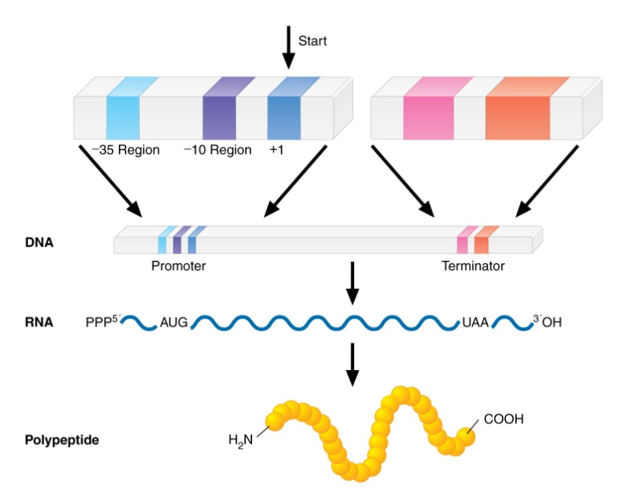
Stages = Initiation, Elongation, Termination
Initiation = slow: RNA pol (RNAP) holoenzyme “slides” along dsDNA until it reaches a promoter ←recognized by σ factor ( ).
Promoter
(-35 -10)
RNAP holoenzyme unwinds DNA to begin synthesis using one DNA strand (-) as template.
1st ribonucleotide is base paired with the transcription start nucleotide (+1) in template DNA.
About 10 more nucleotides are slowly polymerized as RNAP tries to ‘clear’ the promoter
σ factor then leaves RNAP holoenzyme → “core” RNA pol rapidly moves “downstream”, synthesizing RNA in the 5’→3’ direction.

